Slide 1
CHAPTER 10: STORAGE AND FILE STRUCTURE

Slide 2

Storage Hierarchy
Primary Storage
Volatile
Storage
Non-
-Volatile
Storage
Secondary
Storage
Tertiary
Storage

Slide 3

Magnetic Hard Disk Mechanism
NOTE: Diagram is schematic, and simplifies the structure of actual disk drives

Slide 4
Performance Measures of Disks
Access time – the time it takes from when a read or write request is issued to when data transfer begins. Consists of:
  Seek time – time it takes to reposition the arm over the correct track.
    4 to 10 milliseconds on typical disks
  Rotational latency – time it takes for the sector to be accessed to appear under the head.
    4 to 11 milliseconds on typical disks (5400 to 15000 r.p.m.)
Data-transfer rate – the rate at which data can be retrieved from or stored to the disk.
  25 to 100 MB per second max rate, lower for inner tracks

Slide 5
FILE ORGANIZATION, RECORD ORGANIZATION AND STORAGE ACCESS

Slide 6
File Organization
The database is stored as a collection of files. Each file is a sequence of records. A record is a sequence of fields.
We first consider fixed length records, then extend to variable length records.

Slide 7

Fixed-Length Records
Simple approach:
  Store record i starting from byte n ∗ (i – 1), where n is the size of each record.
  Record access is simple but records may cross blocks
    Modification: do not allow records to cross block boundaries
Deletion of record i:
alternatives:
  move records i + 1, . . ., n
  to i, . . . , n – 1
  move record n to i
  do not move records, but
  link all free records on a
  free list

Slide 8
typeinstructor=record
ID varchar(5);
Name varchar(20);
Deptname varchar(20);
Salary numeric(8,2);
end

Slide 9

Free Lists
Store the address of the first deleted record in the file header.
Use this first record to store the address of the second deleted record, and so on
Can think of these stored addresses as pointers since they “point” to the location of a record.
More space efficient representation: reuse space for normal attributes of free records to store pointers. (No pointers stored in in-use records.)

Slide 10

Variable-Length Records
Variable-length records arise in database systems in several ways:
  Storage of multiple record types in a file.
  Record types that allow variable lengths for one or more fields such as strings (varchar)
  Record types that allow repeating fields (used in some older data models).
Attributes are stored in order
Variable length attributes represented by fixed size (offset, length), with actual data stored after all fixed length attributes
Null values represented by null-value bitmap

Slide 11

Variable-Length Records: Slotted Page Structure
Slotted page header contains:
  number of record entries
  end of free space in the block
  location and size of each record
Records can be moved around within a page to keep them contiguous with no empty space between them; entry in the header must be updated.
Pointers should not point directly to record — instead they should point to the entry for the record in header.

Slide 12
Organization of Records in Files
Heap – a record can be placed anywhere in the file where there is space
Sequential – store records in sequential order, based on the value of the search key of each record
Hashing – a hash function computed on some attribute of each record; the result specifies in which block of the file the record should be placed

Slide 13
Data Dictionary Storage
The Data dictionary (also called system catalog) stores metadata; that is, data about data, such as
Information about relations
  names of relations
  names, types and lengths of attributes of each relation
  names and definitions of views
  integrity constraints
User and accounting information, including passwords
Statistical and descriptive data
  number of tuples in each relation
Physical file organization information
  How relation is stored (sequential/hash/…)
  Physical location of relation
Information about indices

Slide 14
Storage Access
A database file is partitioned into fixed-length storage units called blocks. Blocks are units of both storage allocation and data transfer.
Database system seeks to minimize the number of block transfers between the disk and memory. We can reduce the number of disk accesses by keeping as many blocks as possible in main memory.
Buffer – portion of main memory available to store copies of disk blocks.
Buffer manager – subsystem responsible for allocating buffer space in main memory.

Slide 15
DATA INDEXING AND HASHING

Slide 16
Purposes of Data Indexing
What is Data Indexing?
    A database index is a data structure that improves the speed of data retrieval operations on a database table at the cost of additional writes and storage space to maintain the index data structure
Why is it important?

Slide 17
Concept of File Systems
Stores and organizes data into computer files.
Makes it easier to find and access data at any given time.

Slide 18
How DBMS Accesses Data?
The operations read, modify, update, and delete are used to access data from database.
DBMS must first transfer the data temporarily to a buffer in main memory.
Data is then transferred between disk and main memory into units called blocks.

Slide 19
Time Factors
The transferring of data into blocks is a very slow operation.
Accessing data is determined by the physical storage device being used.

Slide 20
Physical Storage Devices
Random Access Memory – Fastest to access memory, but most expensive.
Direct Access Memory – In between for accessing memory and cost
Sequential Access Memory – Slowest to access memory, and least expensive.

Slide 21
More Time Factors
Querying data out of a database requires more time.
DBMS must search among the blocks of the database file to look for matching tuples.

Slide 22
Purpose of Data Indexing
It is a data structure that is added to a file to provide faster access to the data.
It reduces the number of blocks that the DBMS has to check.

Slide 23
Properties of Data Index
It contains a search key and a pointer.
Search key - an attribute or set of attributes that is used to look up the records in a file.
Pointer - contains the address of where the data is stored in memory.
It can be compared to the card catalog system used in public libraries of the past.

Slide 24
Two Types of Indices
Ordered index (Primary index or clustering index) – which is used to access data sorted by order of values.
Hash index (secondary index or non-clustering index ) - used to access data that is distributed uniformly across a range of buckets.

Slide 25
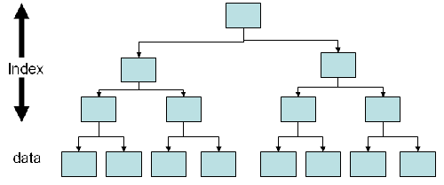
Ordered Index

Slide 26
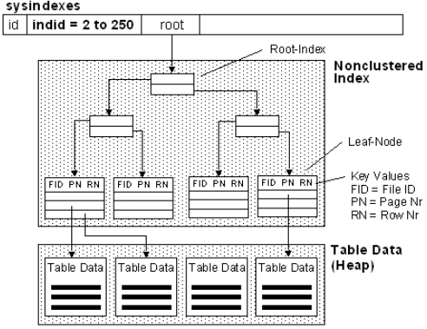
Hash Index

Slide 27
Choosing Indexing Technique
Five Factors involved when choosing the indexing technique:
access type
access time
insertion time
deletion time
space overhead

Slide 28
Indexing Definitions
Access type is the type of access being used.
Access time - time required to locate the data.
Insertion time - time required to insert the new data.
Deletion time - time required to delete the data.
Space overhead - the additional space occupied by the added data structure.

Slide 29
Types of Ordered Indices
Dense index - an index record appears for every search-key value in the file.
Sparse index - an index record that appears for only some of the values in the file.

Slide 30
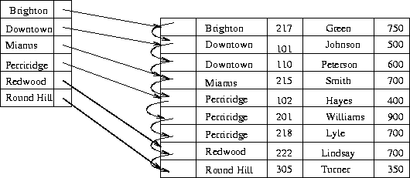
Dense Index

Slide 31
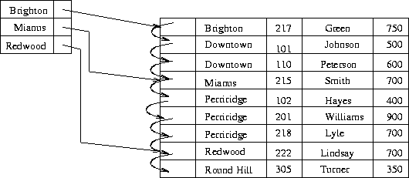
Sparse Index

Slide 32
Index Choice
Dense index requires more space overhead and more memory.
Data can be accessed in a shorter time using Dense Index.
It is preferable to use a dense index when the file is using a secondary index, or when the index file is small compared to the size of the memory.

Slide 33
Choosing Multi-Level Index
In some cases an index may be too large for efficient processing.
In that case use multi-level indexing.
In multi-level indexing, the primary index is treated as a sequence file and sparse index is created on it.
The outer index is a sparse index of the primary index whereas the inner index is the primary index.

Slide 34
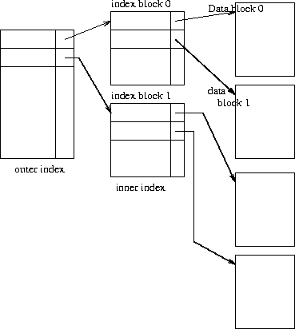
Multi-Level Index

Slide 35
Hashing
Bucket − A hash file stores data in bucket format. Bucket is considered a unit of storage. A bucket typically stores one complete disk block, which in turn can store one or more records.
Hash Function − A hash function, h, is a mapping function that maps all the set of search-keys K to the address where actual records are placed. It is a function from search keys to bucket addresses.
Hash function types
  Uniform
  Random

Slide 36
That is, the hash function assigns each bucket the same number of search-key values from the set of all possible search-key values.
That is, in the average case, each bucket will have nearly the same number of values assigned to it, regardless of the actual distribution of search-key values

Slide 37
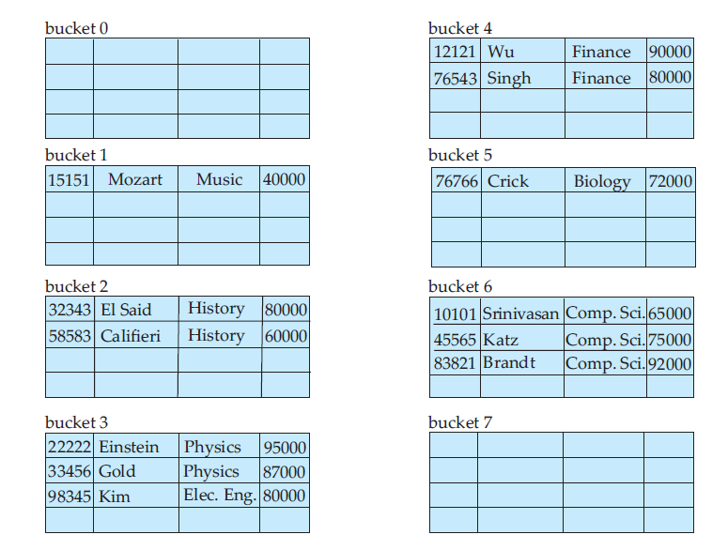

Slide 38
Types of hashing
Static hashing- In static hashing, when a search-key value is provided, the hash function always computes the same address.
Dynamic hashing-The problem with static hashing is that it does not expand or shrink dynamically as the size of the database grows or shrinks. Dynamic hashing provides a mechanism in which data buckets are added and removed dynamically and on-demand. Dynamic hashing is also known as extended hashing.

Slide 39
Bucket Overflows(Collision )
If the bucket does not have enough space, a bucket overflow is said to occur.
Reasons:
Insufficient buckets
Skew

Slide 40
Insufficient buckets. The number of buckets, which we denote nB,
must be chosen such that nB > nr / fr,
  where nr denotes the total number of records that will be stored and
  fr denotes the number of records that will fit in a bucket.

Slide 41
Skew. Some buckets are assigned more records than are others, so a bucket may overflow even when other buckets still have space.
    1. Multiple records may have the same search key.
    2. The chosen hash function may result in nonuniform distribution of search keys.

Slide 42
Solution 1
So that the probability of bucket overflow is reduced, the number of buckets is chosen to be (nr / fr ) ∗ (1 + d), where d is a fudge factor, typically around 0.2.
Some space is wasted: About 20 percent of the space in the buckets will be empty.
But the benefit is that the probability of overflow is reduced.

Slide 43
overflow buckets –solution2
overflow buckets- The condition of bucket-overflow is known as collision.
Solution:
Overflow Chaining − When buckets are full, a new bucket is allocated for the same hash result and is linked after the previous one. This mechanism is called Closed Hashing.
Linear Probing − When a hash function generates an address at which data is already stored, the next free bucket is allocated to it. This mechanism is called Open Hashing.

Slide 44
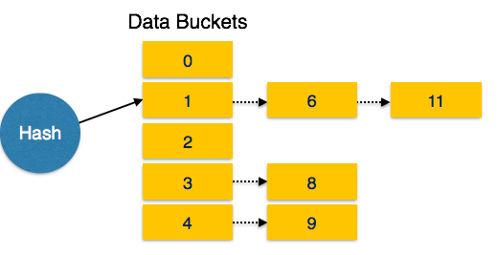
The form of hash structure that we have just described is sometimes referred to as closed hashing.

Slide 45
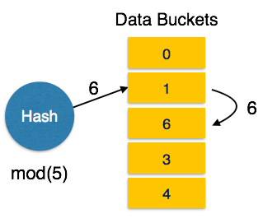
Under an alternative approach, called open hashing, the
set of buckets is fixed, and there are no overflow chains. Instead, if a bucket is
full, the system inserts records in some other bucket in the initial set of buckets B.

Slide 46
Dynamic Hashing
Most databases grow larger over time.

Slide 47
for such a database, we have three classes of options:
1 Choose a hash function based on the current file size. This option will result in performance degradation as the database grows.

Slide 48
2 Choose a hash function based on the anticipated size of the file at some point in the future. Although performance degradation is avoided, a significant amount of space may be wasted initially.

Slide 49
3 Periodically reorganize the hash structure in response to file growth. Such a reorganization involves choosing a new hash function,
Re-computing the hash function on every record in the file, and generating new bucket assignments
This reorganization is a massive, time-consuming operation.

Slide 50
HASHING EXAMPLE

Slide 51
Example
Suppose A company with 250 employees assign a 5-digit employee number to each employee which is used as primary key in company’s employee file.
  We can use employee number as a address of record in memory.
  The search will require no comparisons at all.
  Unfortunately, this technique will require space for 1,00,000 memory locations, where as fewer locations would actually used.
  So, this trade off for time is not worth the expense.

Slide 52
Hashing
The general idea of using the key to determine the address of record is an excellent idea, but it must be modified so that great deal of space is not wasted.
This modification takes the form of a function H from the set K of keys in to set L of memory address.
    H: K L , Is called a Hash Function or
    Unfortunately, Such a function H may not yield distinct values: it is possible that two different keys k1 and k2 will yield the same hash address. This situation is called Collision, and some method must be used to resolve it.

Slide 53
Hash Functions
the two principal criteria used in selecting a hash function H: K L are as follows:
The function H should be very easy and quick to compute.
The function H should as far as possible, uniformly distribute the hash address through out the set L so that there are minimum number of collision.

Slide 54
Hash Functions
1. Division method: choose a number m larger than the number n of keys in K. (m is usually either a prime number or a number without small divisor) the hash function H is defined by
H(k) = k (mod m) or H(k) = k (mod m) + 1.
here k (mod m) denotes the reminder when k is divided by m. the second formula is used when we want a hash address to range from 1 to m rather than 0 to m-1.
2. Midsquare method: the key k is squared. Then the hash function H is defined by H(k) = l. where l is obtained by deleting digits from both end of k^2.
3. Folding Method: the key k is portioned into a number of parts, k1, k2, ……,kr, where each part is added togather, ignoring the last carry.
H(k) = k1+k2+ ……………+Kr.
Sometimes, for extra “milling”, the even numbered parts, k2, k4, …. Are each reversed befor addition.

Slide 55
Example of Hash Functions
Consider a company with 68 employees assigns a 4-digit employee number to each employee. Suppose L consists of 100 two-digit address: 00, 01, 02 , ……….99. we apply above hash functions to each of following employee numbers: 3205, 7148,2345.
1. Division Method:
choose a prime number m close to 99, m=97.
H(k)=k(mod m): H(3205)=4, H(7148)=67, H(2345)=17.
2. Midsquare Method:
k= 3205 7148 2345
k^2= 10272025 51093904 5499025
H(k)= 72 93 99
3. Folding Method: chopping the key k into two parts and adding yield the following hash address:
H(3205)=32+05=37, H(7148)=71+48=19, H(2345)=23+45=68
Or,
H(3205)=32+50=82, H(7148)=71+84=55, H(2345)=23+54=77

Slide 56
Collision Resolution
Suppose we want to add a new record R with key K to our file F, but suppose the memory location address H(k) is already occupied. This situation is called Collision.
There are two general ways to resolve collisions :
    Open addressing,(array method)
    Separate Chaining (linked list method)

